Slide 1

Book recommendation system
BY:
Ayesha Mubashir and Quan Ta

Slide 2

Introduction
Information of the Dataset
Type of the system
System process

Slide 3
Introduction of Dataset:
Book: https://www.kaggle.com/zygmunt/goodbooks-10k
This dataset consists of the metadata of 10,000 books and over 53,000 users’ ratings. The metadata of each book includes its ID, Authors, ISBN, Title, the language used in it, and the number of ratings.

Slide 4
SYSTEM TYPE:
In our project we are using recommender system for book dataset.
This system is divided into two types:
Content based and collaborative filtering-based systems
We want to build a content-based recommender system. In this system we build a profile for the items based on the author and the rating of one book, we can recommend the users with books that they may like according to the authors and the tags.
This system works with user provide data or rating which is helpful to make suggestion for users. It is also widely used for recommending things such as articles, movies and so on.

Slide 5
Introduction of the system process
Platform
Methods
Models

Slide 6
platform of system process
We are using Jupyter notebook in order to build that system by using python language and implementing libraires in python.

Slide 7

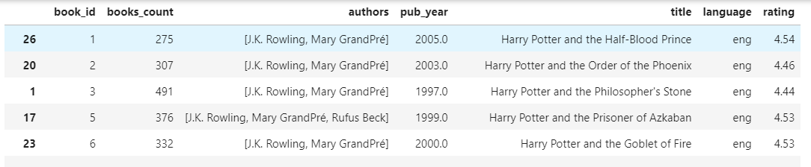
DAta PreProcessing
We only select certain columns for the dataset.
We drop the null values in the datasets
The number of row reduces from 10000 to 8405

Slide 8
Which model we are using ?
We are using vector space model and cosine similarity .
In this model each item we stored as a vector in an n-dimensional space.
Vectors are calculated to determine the similarity between the vector
Cosine similarity is measurement between two non-zero vectors of inner product which measure how similar two items are and distance between two vectors.

Slide 9
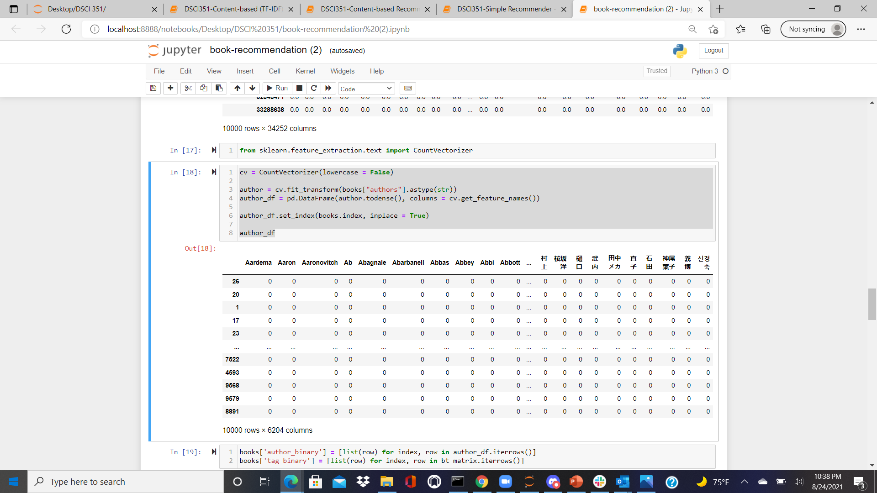
Vector space model:

Slide 10
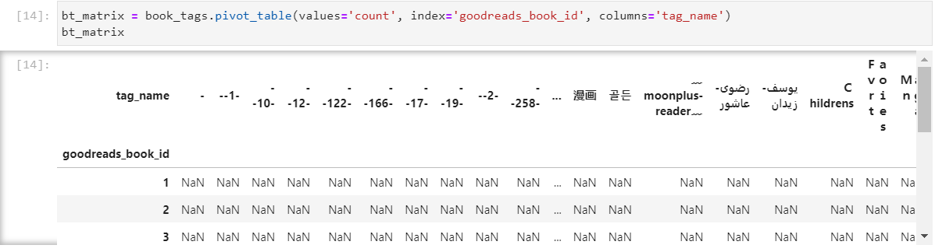
Vector space model:

Slide 11
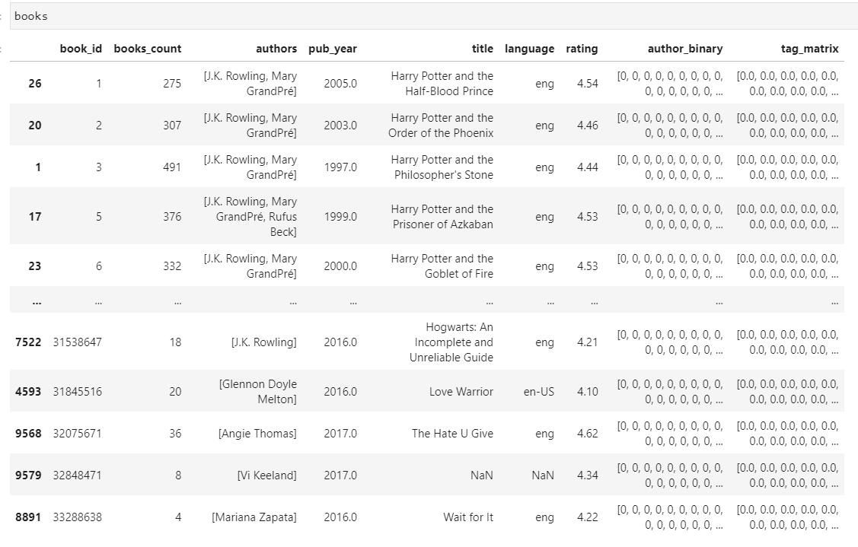
Vector space model:
We generate two new columns author_binary and tag_matrix
The dimension of the final dataset is 8405 rows × 9 columns

Slide 12
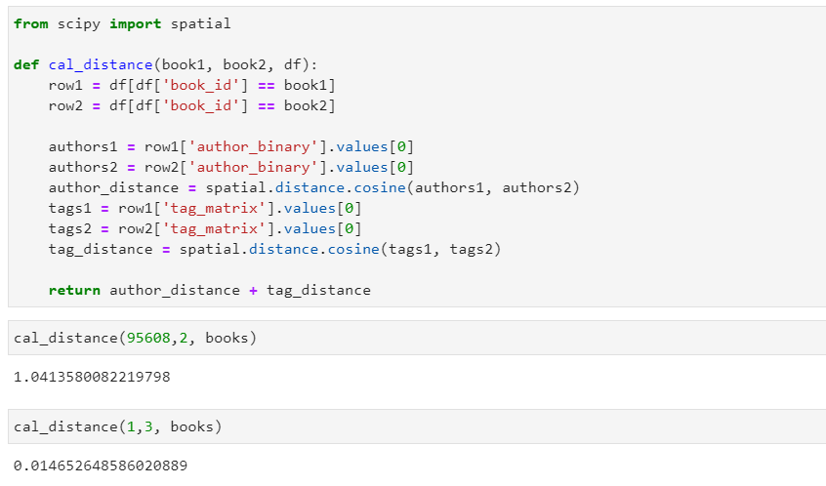
COINE SIMILARITY model:

Slide 13
Methods:
get_rated_books function gave us the list of book greater than 4 rating
01
top_k_neighbor function to find the nearest neighbor.
02
Recommend_book function recommend the book according to the user rating
03

Slide 14
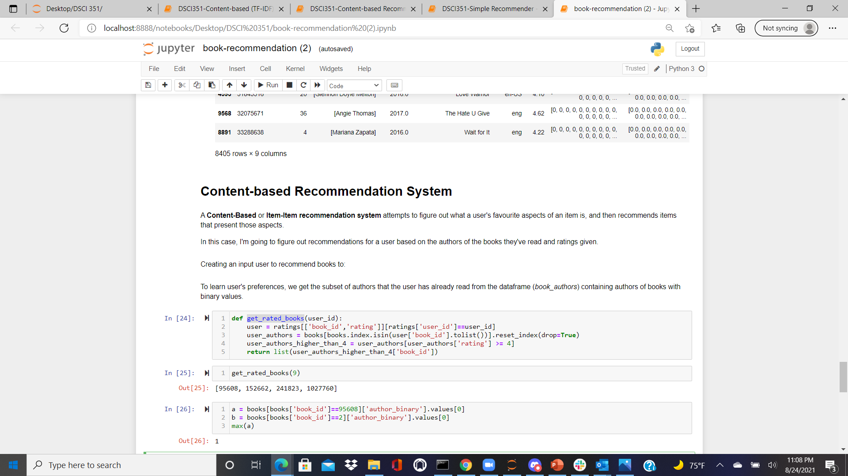
Get_rated_books:

Slide 15
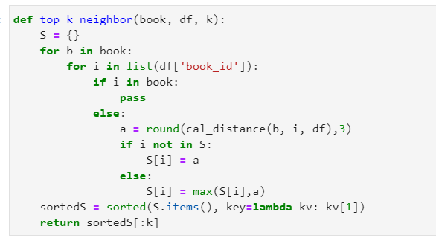
Top_k_neighbour:

Slide 16
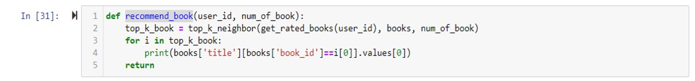
Recommend_book method:

Slide 17
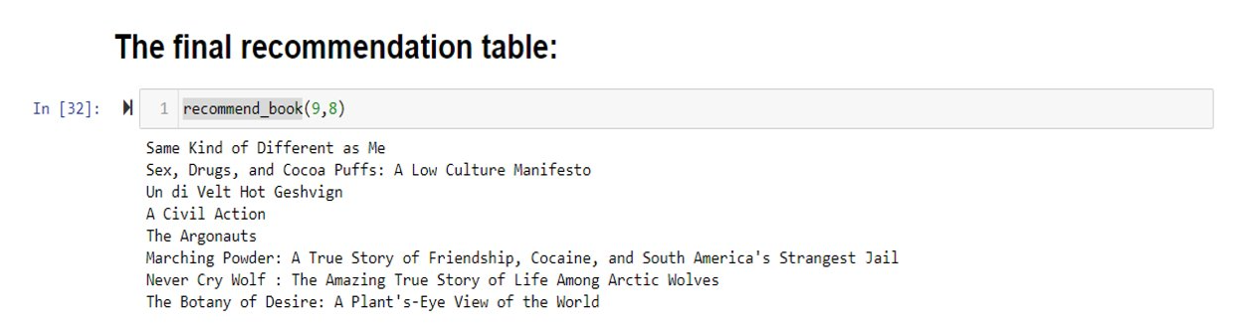
Results:
We can see the 8 books that are the most similar to those the user rated over 4.

Slide 18
Evaluation
Evaluation the system based on:
Coverage: We did not cover books that are rated lower than 4, as well as books that contain null values.
Novelty: We are likely to recommend books that the user may not aware of their existence.
Due to the tags are considered of the recommender system.
Accuracy: Using Root Mean Square Error (RMSE)
The accuracy is 0.8443230986313482

Slide 19
Limitation
The tag and author names are sometimes not in English
The number of books the user rated may cause the recommender to run slow
We have not taken many features into consideration.

Slide 20

Thank You

